Slide 1

CSVTU GPT
Chhattisgarh Swami Vivekanand Technical University
Minor Project Based On Industrial Training
Guided By
Mr. Abhinaw Jagtap
Assistant Professor
CSE
Presented By
Yash Kushwaha Nikhil Kumar Yadav Madhurima Rawat

Slide 2
Contents
Problem Statement
Technology Used
Implementation of CSVTU GPT
Methodology

Slide 3
Problem Statement
Developing a Generative Pre-trained Transformer (GPT) model tailored to the context of Chhattisgarh Swami Vivekanand Technical University (CSVTU).
The model will be capable of understanding and generating text relevant to the university, potentially assisting in tasks such as answering course-related queries, summarizing research papers, or drafting university announcements.

Slide 4
Technology Used
Web Scraping: A method for extracting data from websites. It’s used here for data collection.
BeautifulSoup: A Python library used to extract data from HTML and XML documents. It’s used here to get raw data from university websites.
PyPDF2: A Python library used to read and extract text from PDF files. It’s used here to extract text from PDFs.
Python Libraries: Used for data processing. These libraries provide pre-defined functions for easier and efficient data processing.
Large Language Model (LLM): Will be used to train model on data collected to understand existing content and generate original content.

Slide 5
Implementation of CSVTU GPT
Data collection:- Web scrapping is used for data collecting. BeautifulSoup is used to get the raw data from the university websites. PyPDF2 helps us to extract text from pdfs.
Data Processing:- It is done by using Python libraries.
Training:- The model is trained on a massive data set containing diverse and unlabeled text from the website.

Slide 6
Methodology
Web Scraping Completed: The data collection phase has been successfully completed using web scraping techniques. The data from university websites has been gathered.
LLM Model Training: The next phase of the project will involve training the Language Model (LLM) on the collected data. Model is trained and after this hyperparameter tuning will be done.
Deployment: This will be done in the upcoming stages of the project.

Slide 7
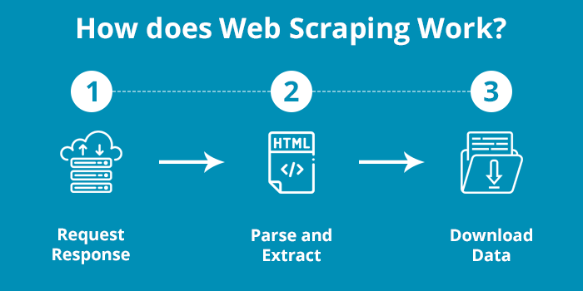

Slide 8
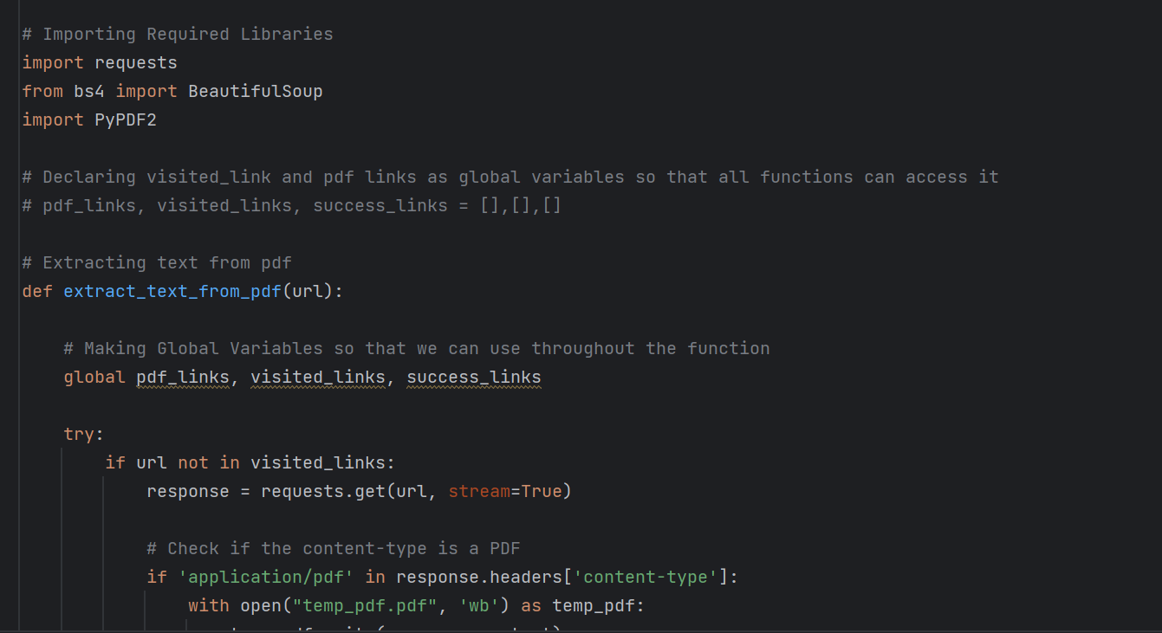

Slide 9
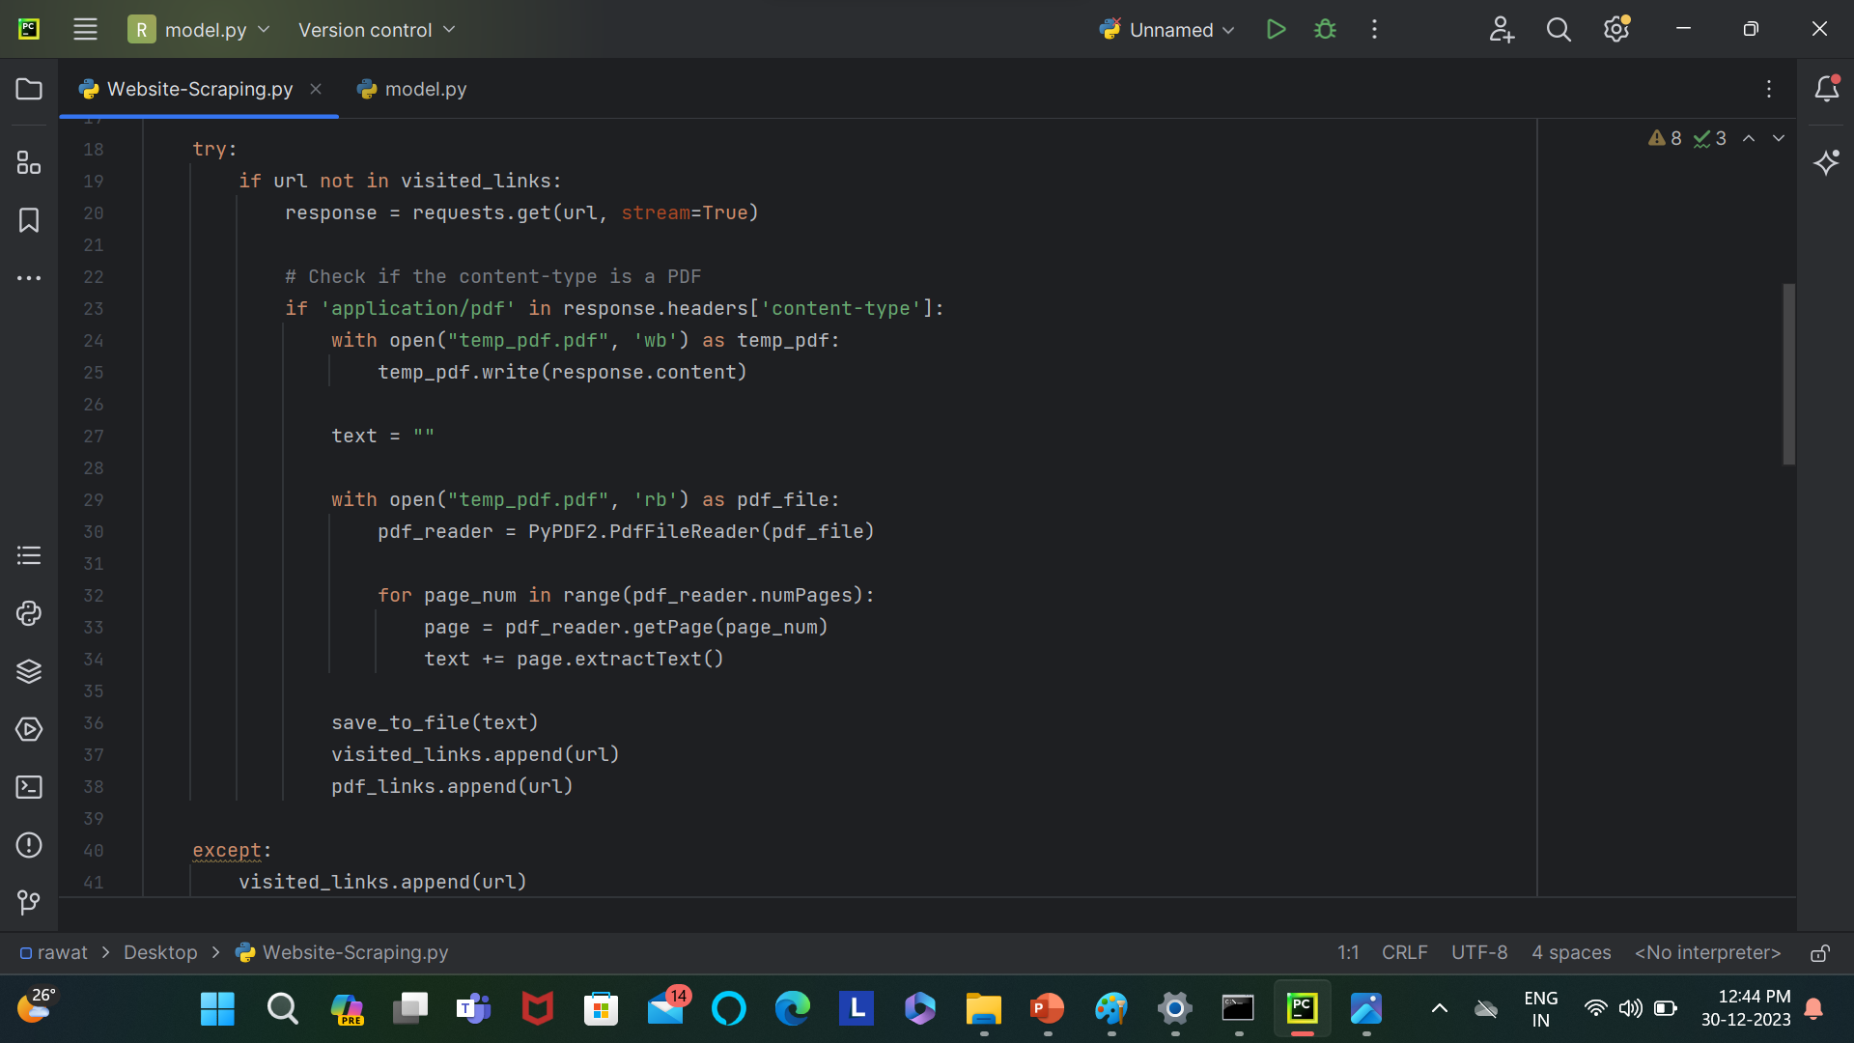

Slide 10
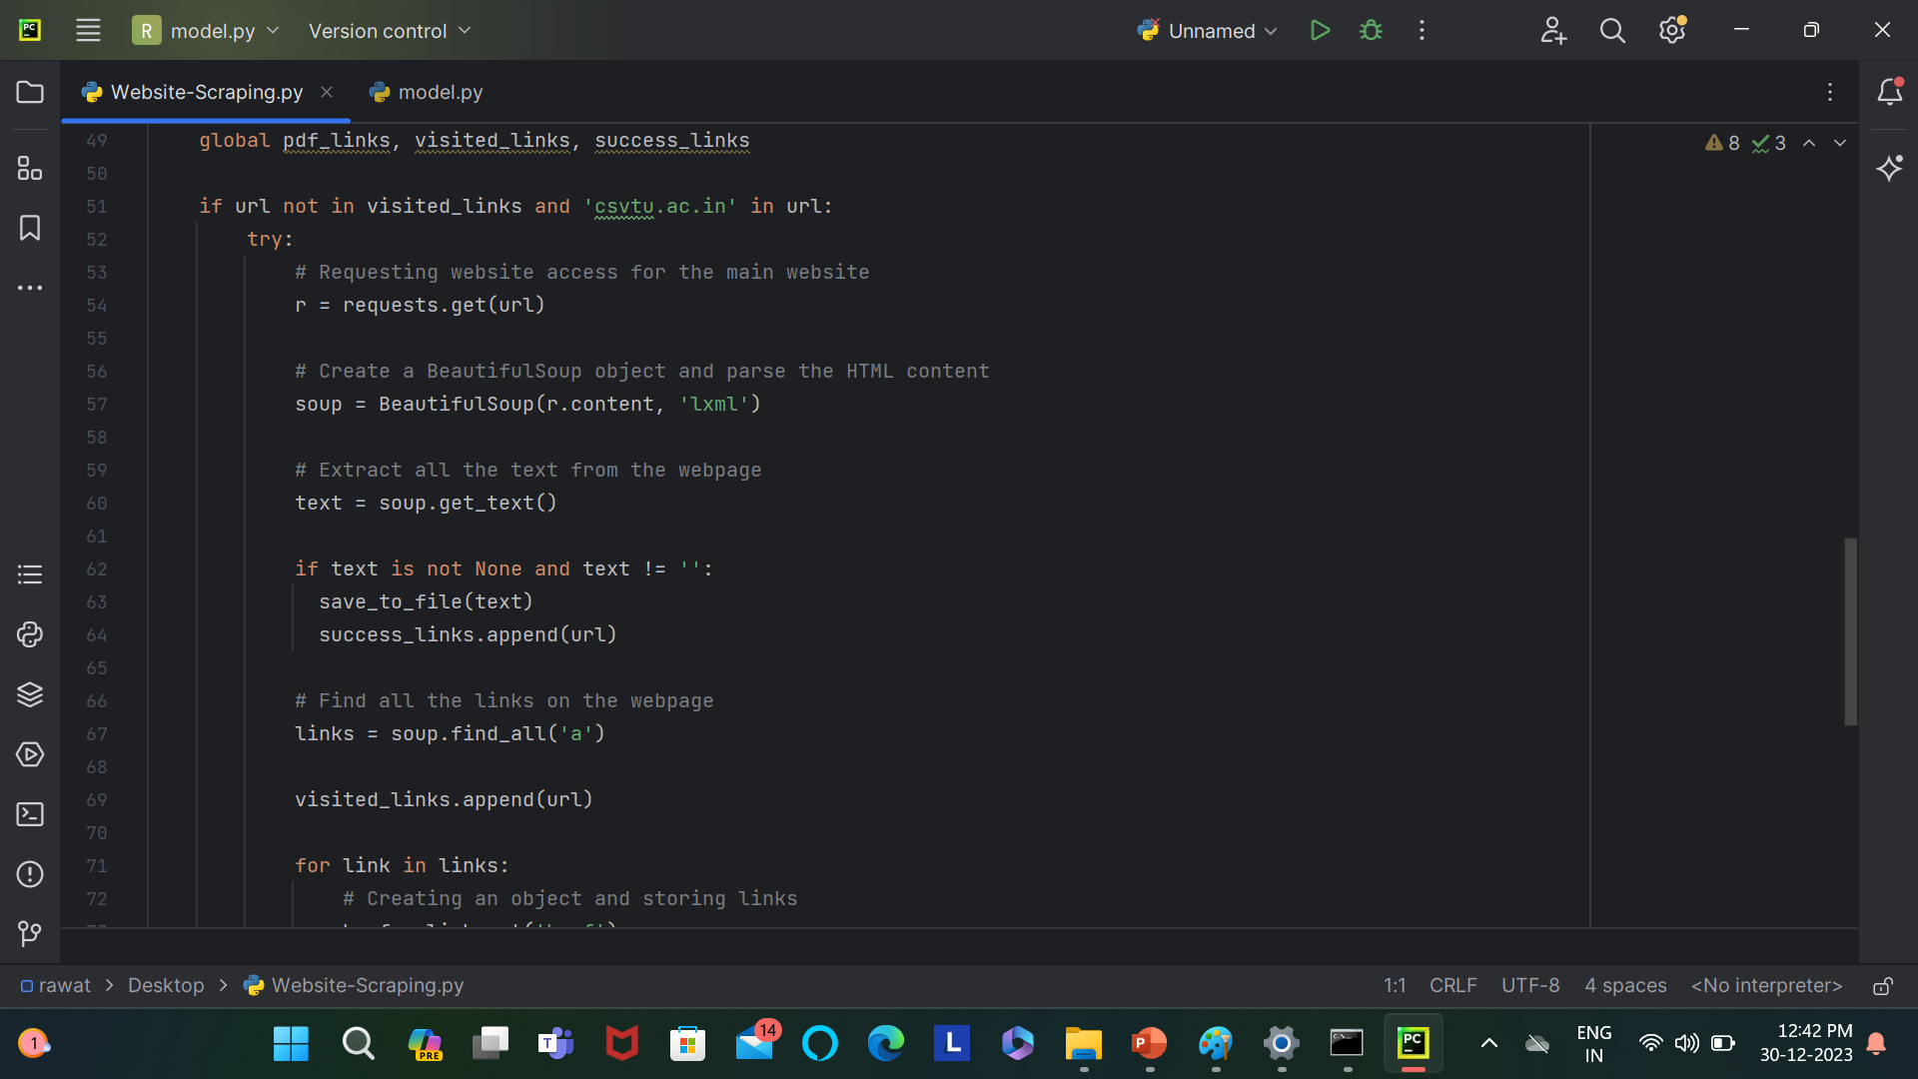

Slide 11
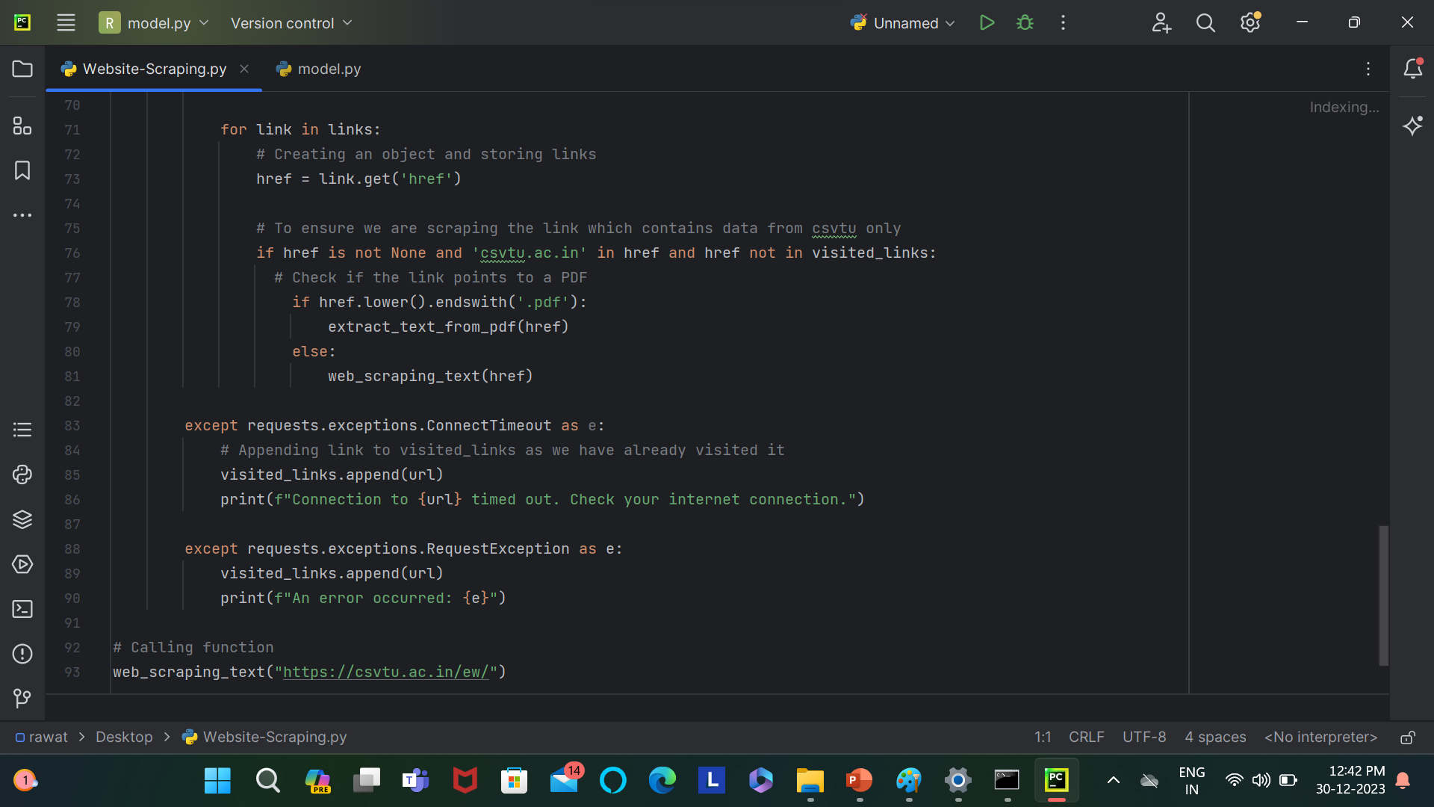

Slide 12
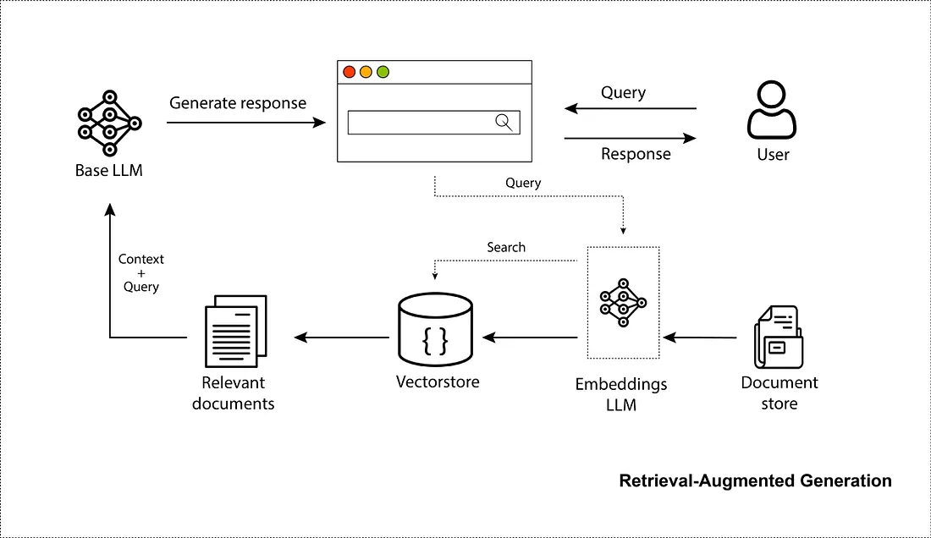

Slide 13
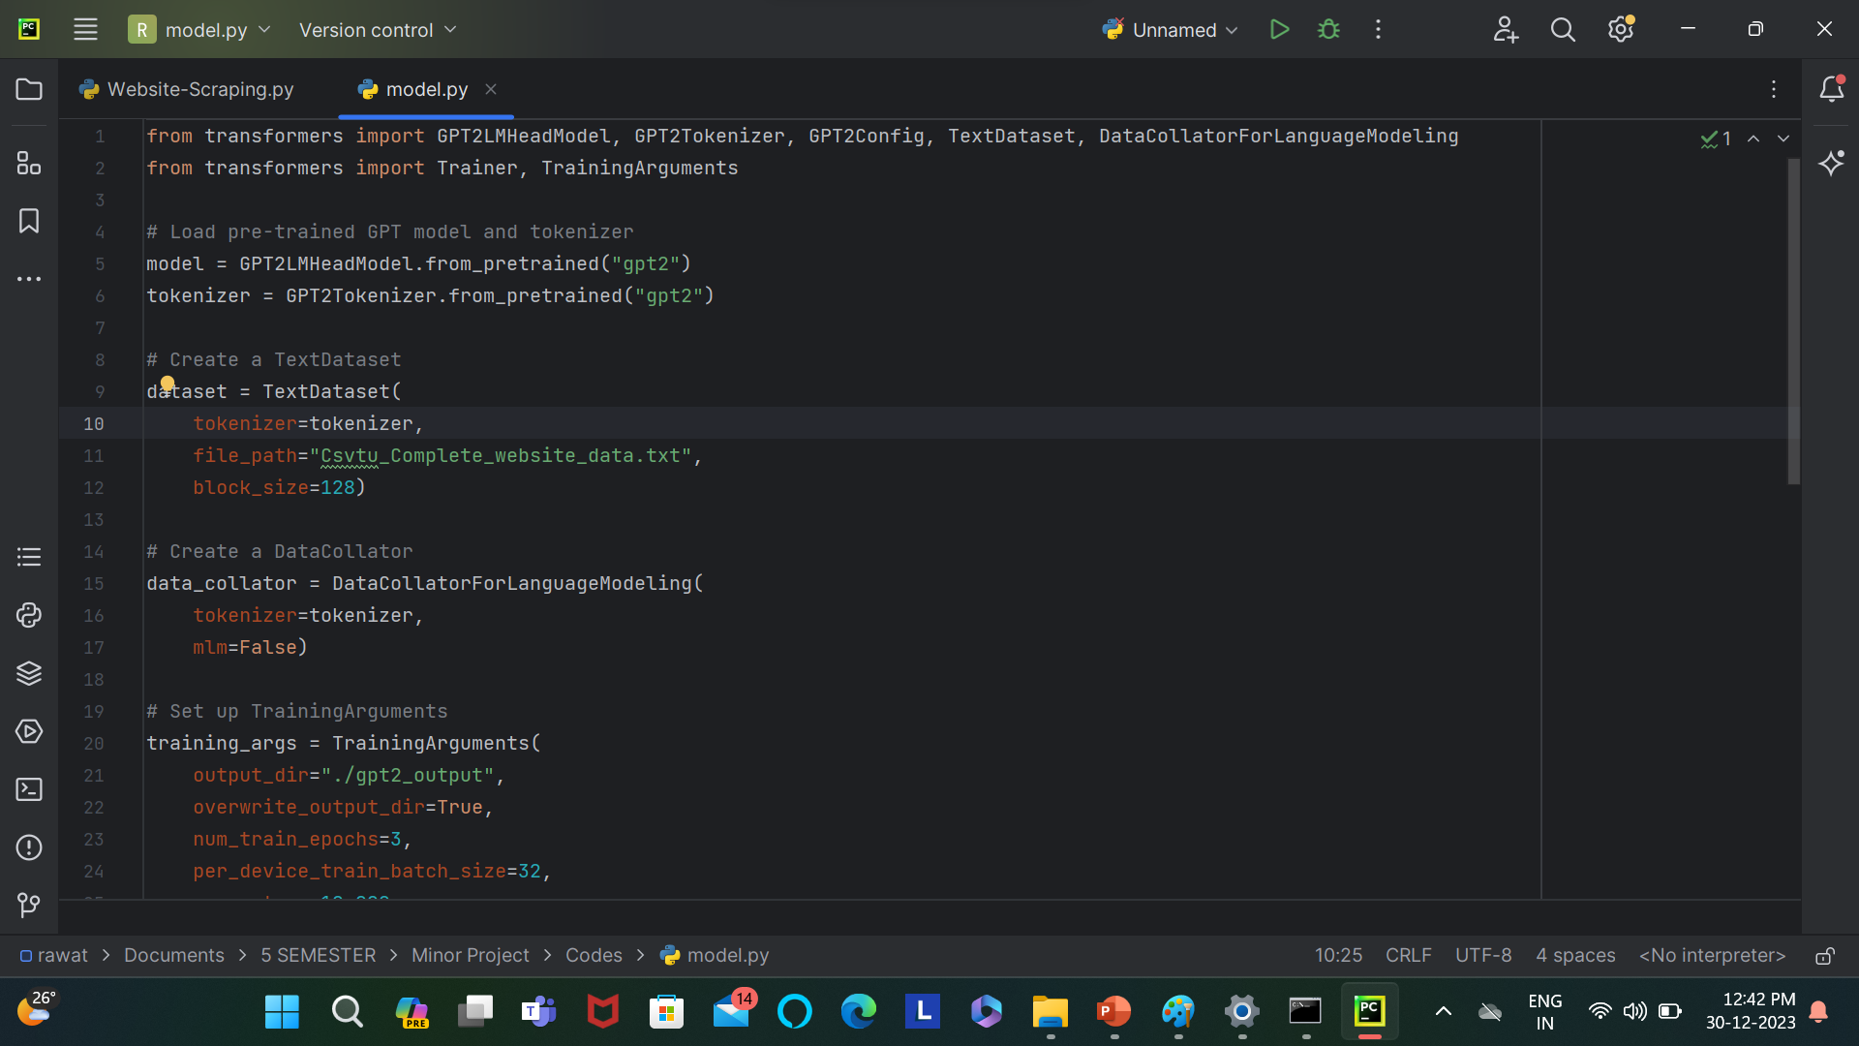

Slide 14
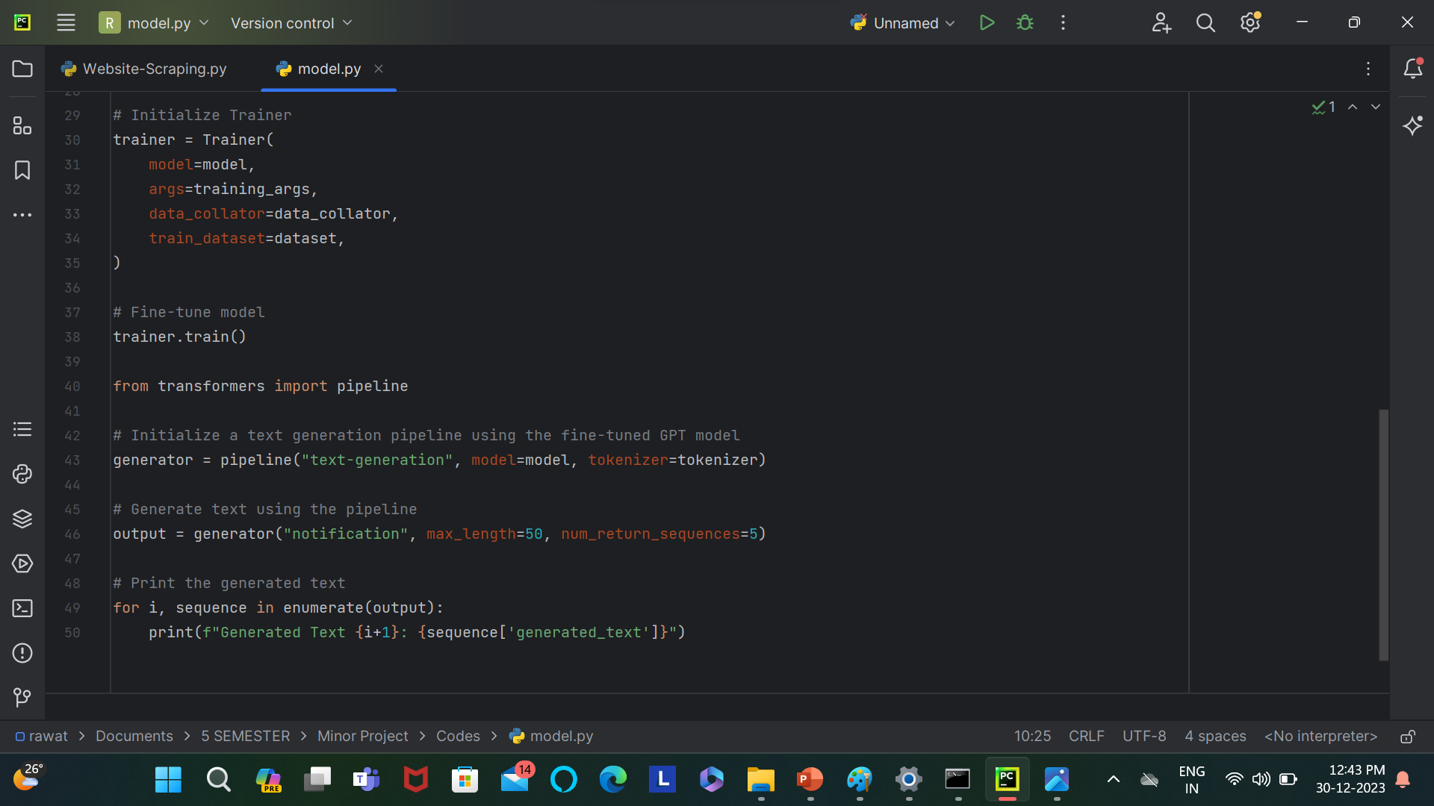

Slide 15
THANK YOU

